Slide 1

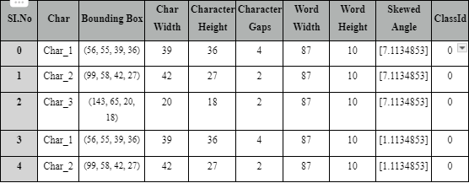
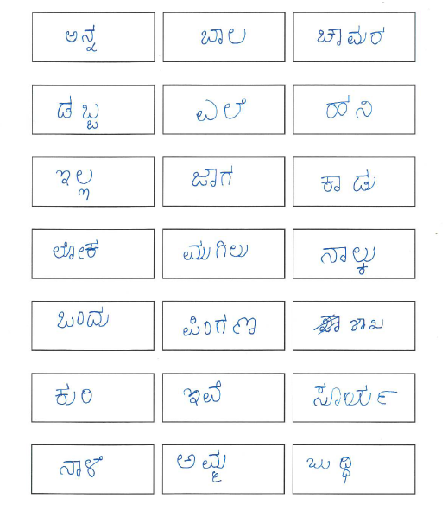
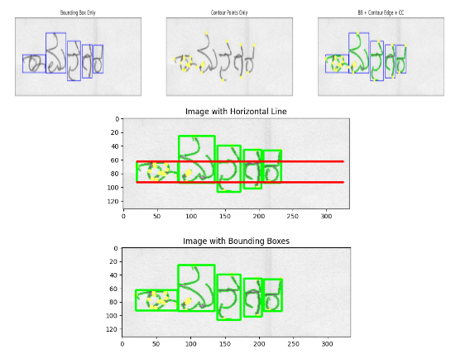
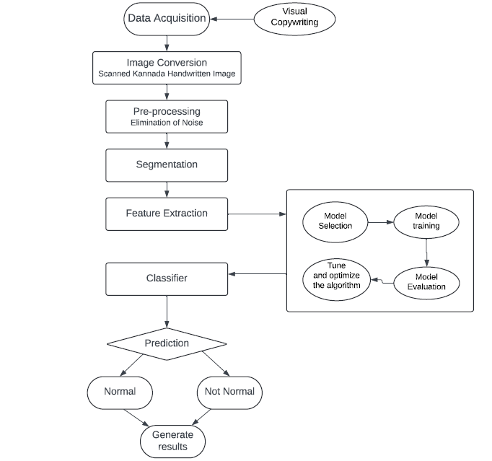
Detection of SLD in Kannada Vocabulary amongst Undergraduate Students
Umang Goel 1BM20CS176 | Tushar B T 1BM20CS174 | Varun Urs M S 1BM20CS182 | Vinay Kulkarni 1BM20CS188 | Guide : Dr. Kavitha Sooda Professor
Department of Computer Science and Engineering, B.M.S. College of Engineering, Bangalore-560019.
Introduction
Specific Learning Disabilities (SLD) represent a significant challenge for individuals in educational settings worldwide. Defined as neurological disorders that affect the brain's ability to receive, process, store, and respond to information effectively, SLD can manifest in various forms, impacting a person's learning capabilities in specific areas such as reading, writing, and mathematics. Despite advances in understanding and support, SLD continues to pose obstacles to academic achievement and personal development for many individuals. Even with technology getting better, writing by hand is still really important. Talking with others, and showing how you feel. But, some people have a hard time writing neatly and easily due to slow learning disabilities. This makes it tough for them to communicate, express themselves, and capture their ideas. This problem affects 12-33% of kids in school. It can make it hard for them to do well in school, feel good about themselves. It's really important to find out about this problem and get help. Witnessing the struggles faced by young children with slow learning disabilities, particularly within the Kannada-speaking community, inspired us to undertake this research. Existing solutions are often time-consuming, expensive, and lack specific support for diverse languages and cultural backgrounds.
Methodology
1) Data collection of Kannada handwriting from Undergraduate students:
A dataset specific to Kannada is compiled from undergraduate students of BMSCE. These students copied 21 words on an A4 sheet, systematically divided into grid boxes to ensure consistent data capture.
2) Data conversion, pre-processing and segmentation:
Canny edge detection algorithm is applied to grayscale images for contour analysis, capturing sharp transitions between Kannada character strokes effectively.
Grid-based image cropping extracts pertinent writing regions from A4 sheets. Denoising techniques like grayscale conversion simplify image processing by removing irrelevant color information while retaining essential stroke and shading details.
Gaussian blur smoothens the image, reducing isolated pixel variations and improving edge consistency. Thresholding eliminates undesired artifacts by binarizing images to clearly differentiate strokes from the background. Pressure is labeled using manual methods for each of the extracted image box.
3) Feature Extraction:
The following six features are chosen as they can be easily identified and analysed by the handwriting analysis - pressure, height and length of the word, skew of the written word, height, length and distance between each character in a word.
Watershed algorithm is applied to thresholded grayscale images with predefined markers to extract each character from the whole word. Watershed effectively handles touching or overlapping characters by identifying valleys between strokes as segmentation points.
These features are extracted by drawing the bounding boxes and contours around each character in the word and taking the highest and lowest points of each character.
4) Prediction of SLD using models trained on the extracted data:
For this project, Convolutional Neural Network (CNN) and Random Forest models are utilized for analyzing and classifying the extracted features from Kannada character images.
CNNs are employed to learn and extract hierarchical representations of Kannada characters from the preprocessed images.
CNNs are adept at capturing intricate patterns and structures within images, making them suitable for character recognition tasks.
In this project, Random Forest models are utilized to classify extracted features from Kannada character images into different categories.
Random Forest is known for its robustness and ability to handle high-dimensional features.
Proposed System
To address the limitations of existing slow learning disability detection systems, we've built a novel approach specifically for Kannada handwriting. Unlike systems reliant on expensive tablets, our system will be accessible and affordable.
In our proposed system, we have collected Kannada-specific data from undergraduate students of BMSCE. These students wrote 21 kannada words on an A4 sheet divided into grid boxes for consistent data capture. There are four steps in this system:
Fig 3. Sample features extracted from the dataset
1. Data collection of Kannada handwriting from Undergraduate students
2. Data conversion, pre-processing and segmentation
3. Feature Extraction
4. Prediction of SLD using models trained on the extracted data
Results
The comparative analysis of Convolutional Neural Network (CNN) and Random Forest models for Kannada character recognition yielded insightful findings. Despite being trained on the same dataset with identical features, the performance of the two models exhibited slight differences.
The CNN model achieved an accuracy of 72.79% in recognizing Kannada characters.
The Random Forest model outperformed the CNN model with an accuracy of 74.26%.
Both models were trained on the same dataset and utilized identical features extracted from the images.
This comparison indicates that while both models performed relatively well, the Random Forest model demonstrated a slightly higher accuracy in recognizing Kannada characters compared to the CNN model.
Fig 4. Sample dataset sheet collected from the students
Conclusion
Slow learning disability detection in people helps to effectively treat them and also prevents low self-esteem. Several methods have been applied to machine learning and deep learning techniques for predicting the probability of having a slow learning disability. Existing methods have limitations such as lower efficiency in feature analysis and overfitting problems. Since our dataset was created from scratch, it includes only a small number of subjects. Moving forward, the aim should be to expand our dataset to encompass a larger and more diverse sample size. By addressing these limitations, this project offers a language-specific, accessible, and accurate solution for slow learning disability detection in Kannada. Our research lays the groundwork for future advancements in dysgraphia diagnosis using machine learning. The future of dysgraphia diagnosis holds promise for greater accuracy and personalized support. One promising avenue is the exploration of multimodal datasets. This means incorporating not just written samples but also data on factors like pressure applied while writing and pen lifts. These additional dimensions could provide a more comprehensive picture of writing difficulties.
Fig 2. Proposed methodology for detection of SLD
Fig 1. Proposed methodology for detection of SLD

